Slide 1
Principles of Drug Discovery
Lecture 3b: Ion Channels

Slide 2
Ion channels are pore-forming membrane proteins whose function is establishing a resting membrane potential, shaping action potentials and other electrical signals by gating the flow of ions across the cell membrane, controlling the flow of ions across membranes, and regulating cell volume.

Slide 3
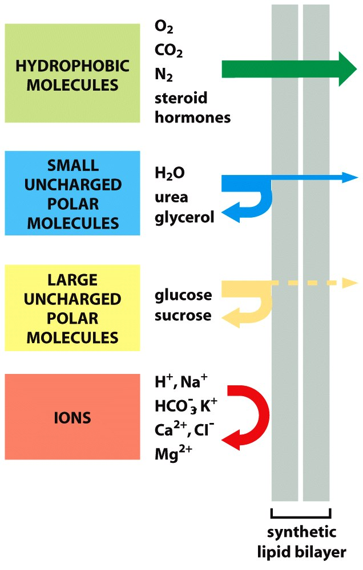
Notes:
Gases and unpolar molecular passively permeate through biological membranes
Small, polar molecules have a very low permability. The permeate through aquaporin water channels.
Larger polar molecules like sugars have even lower permeability. Their transport across membranes is mediated by transporters.
Ions cannot permeate at all. The energy barrier is too high.

Slide 4
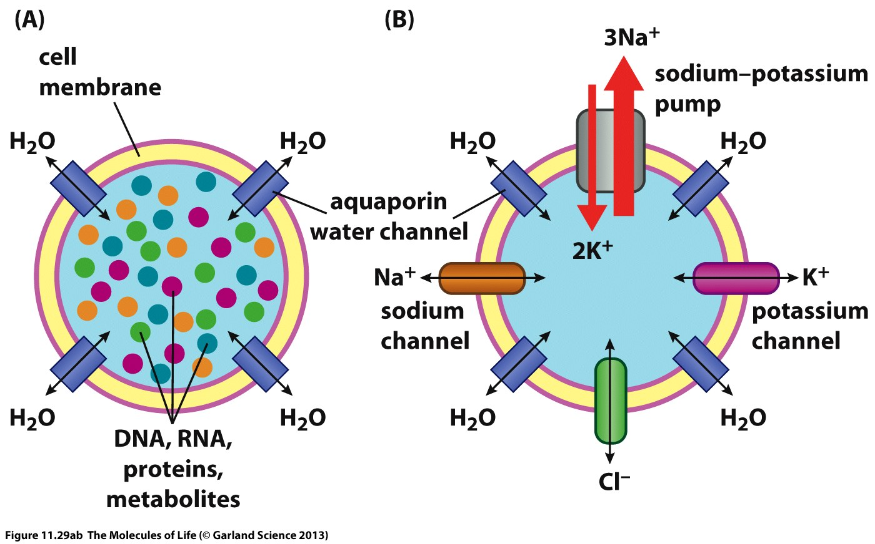
Notes:
Cells, however, need to provide mechanisms to allow exchange polar molecules and ions with their environment. This is achieved through channel proteins which are designed to allow selective permeation.
An essential prerequisite for the function of many cells is the presence of an electrochemical gradient across the cell membrane. This is achieved by ion transporters and ion channels.

Slide 5
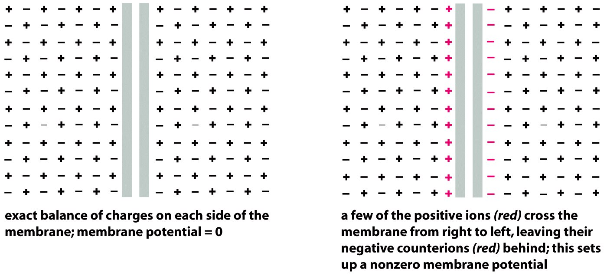
The membrane resting potential
Notes:
The basis for electric signaling is the resting membrane potential.

Slide 6
Cells actively maintain an electrochemical gradient across the membrane through the ATP-driven Na/K-Transporter.
Ion selective K+-channels allow K+-ions to move across the cell membrane
The concentration gradient of K+ across the cell membrane is counter-balanced by an electrochemical gradient which is results in a membrane potential (resting potential)
Extracellular: high Na+, low K+ concentrations
Na⁺
K+
K+
Intracellular: low Na+, high K+ concentrations
Notes:
The Na/K transporter actively transports sodium ions out of the cell which gives rise to a concentration gradient.

Slide 7
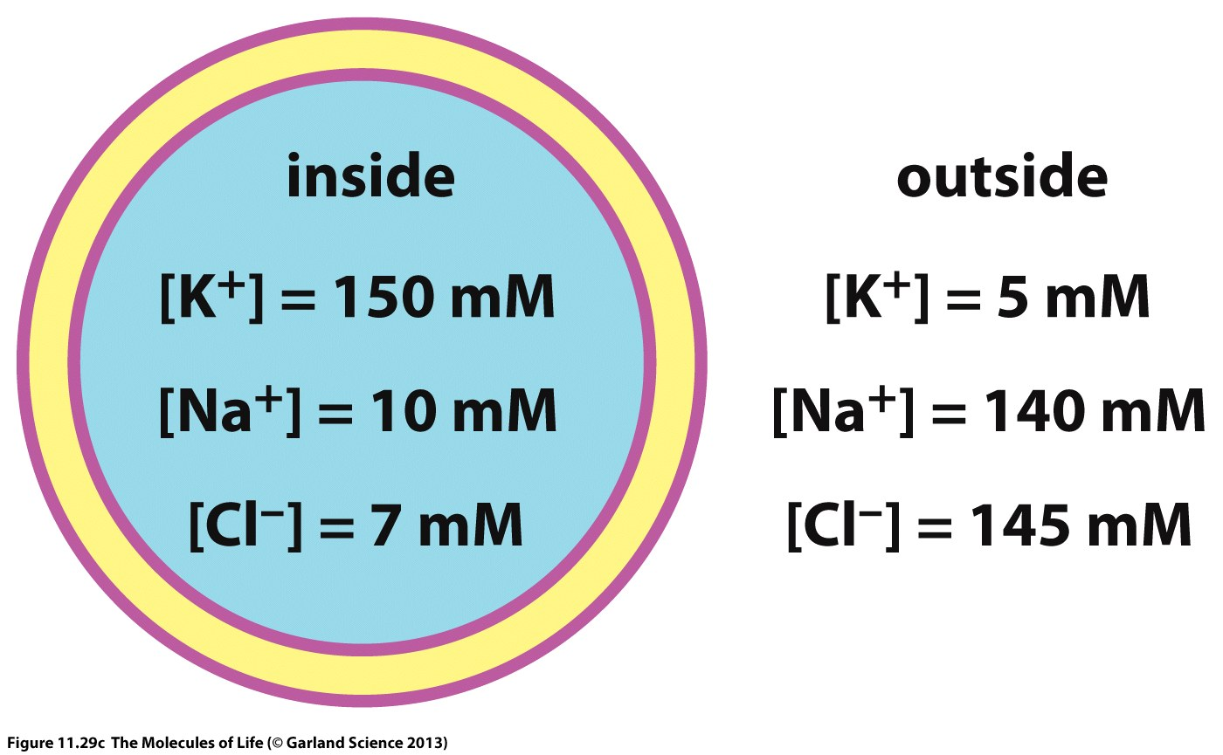

Slide 8
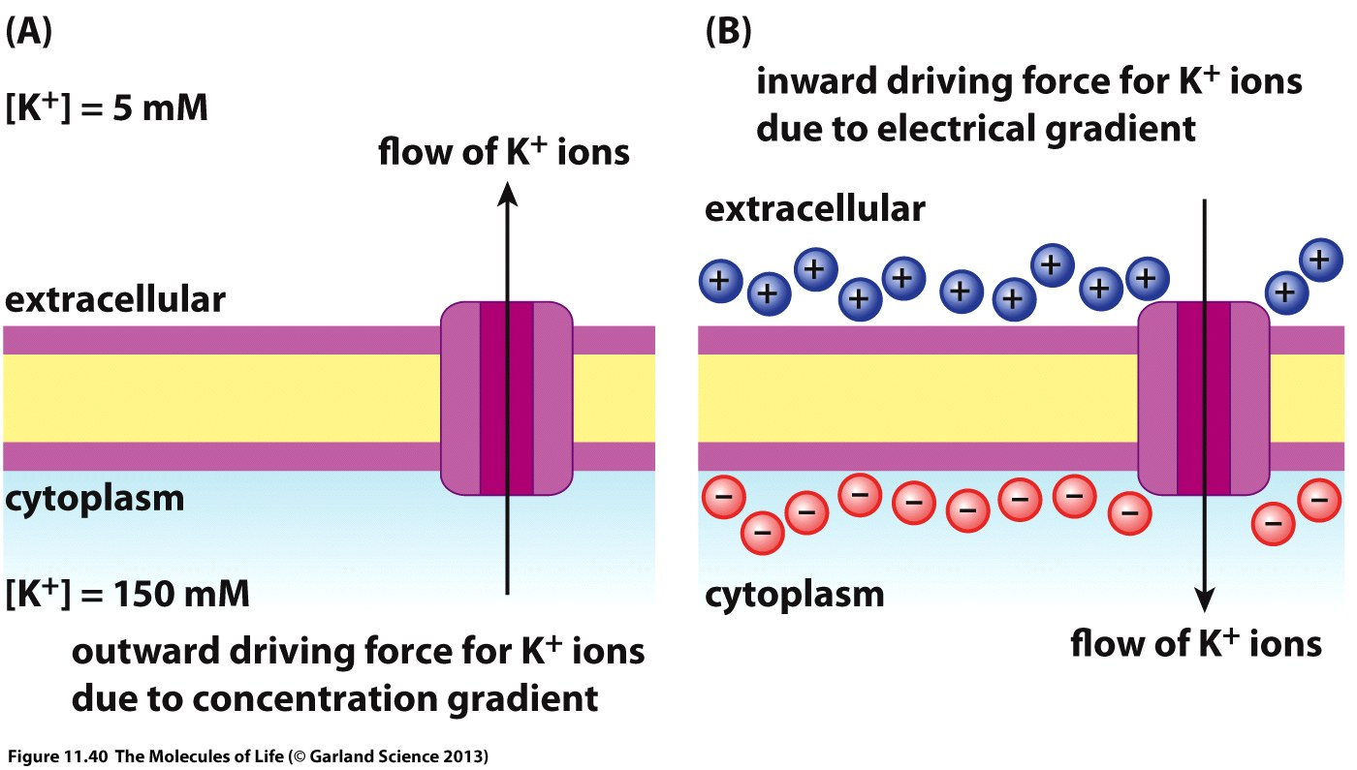
Notes:
The concentration gradient causes an outflux of K+ ions. Since K+ ions are the only ions which can permeate, the selective permeation leaves are charge imbalance with an excess of negative charge in the interior of the cell and an excess of positive charge in the extracellular space. Equilibrium is reached when the electrochemical gradient equals the concentration gradient. The result is a membrane potential.

Slide 9
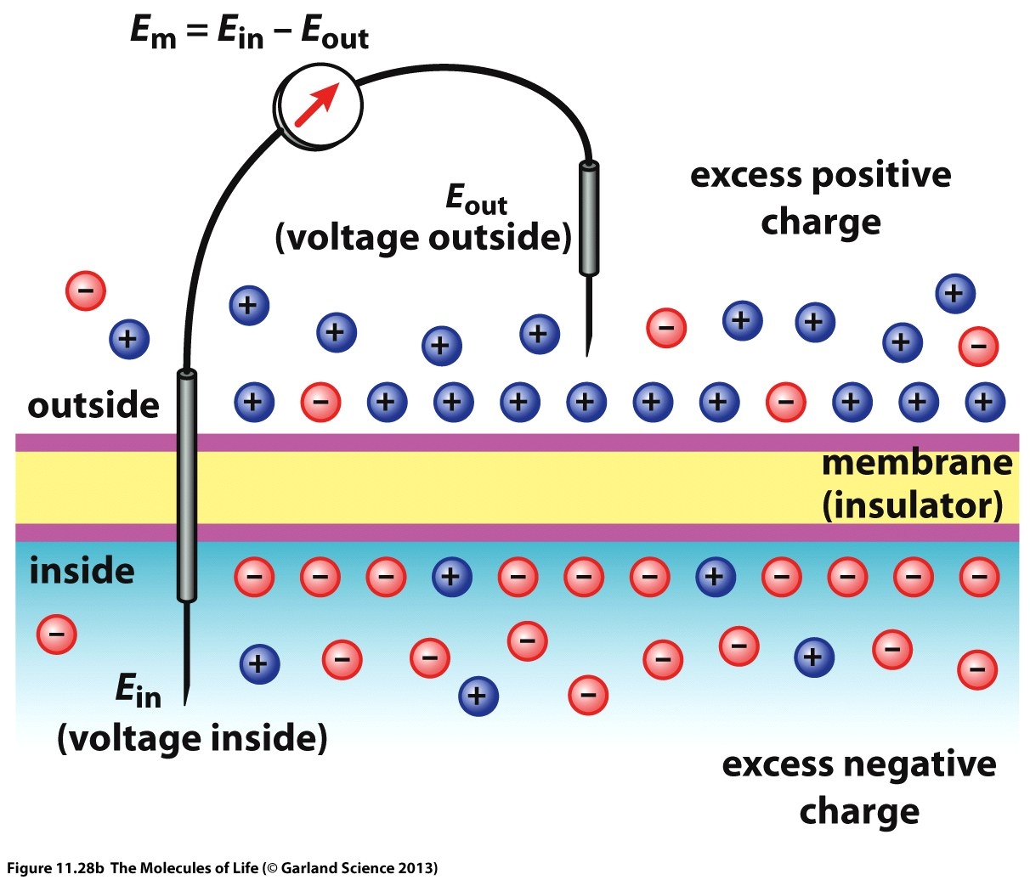

Slide 10
Cells actively maintain an electrochemical gradient across the membrane through the ATP-driven Na/K-Transporter.
Ion selective K⁺-channels allow K⁺-ions to move across the cell membrane
The concentration gradient of K+ across the cell membrane is counter-balanced by an electrochemical gradient which is results in a membrane potential (resting potential)
The resting membrane potential in the range of -20 to -120 mV (-70 mV for neurons).

Slide 11
The membrane potential is the basis for electrical signal transduction
The mediators of electrical signaling in biology are ion channels

Slide 12
Physiological Roles of Ion Channels
Conductance of Nerve impulse, generation of action potential, synaptic transmission.
Cardiac, skeletal and smooth muscle contraction.
Epithelial transport of nutrients and ions.
T-cell activation (immune regulation).
Pancreatic beta cell insulin release.

Slide 13
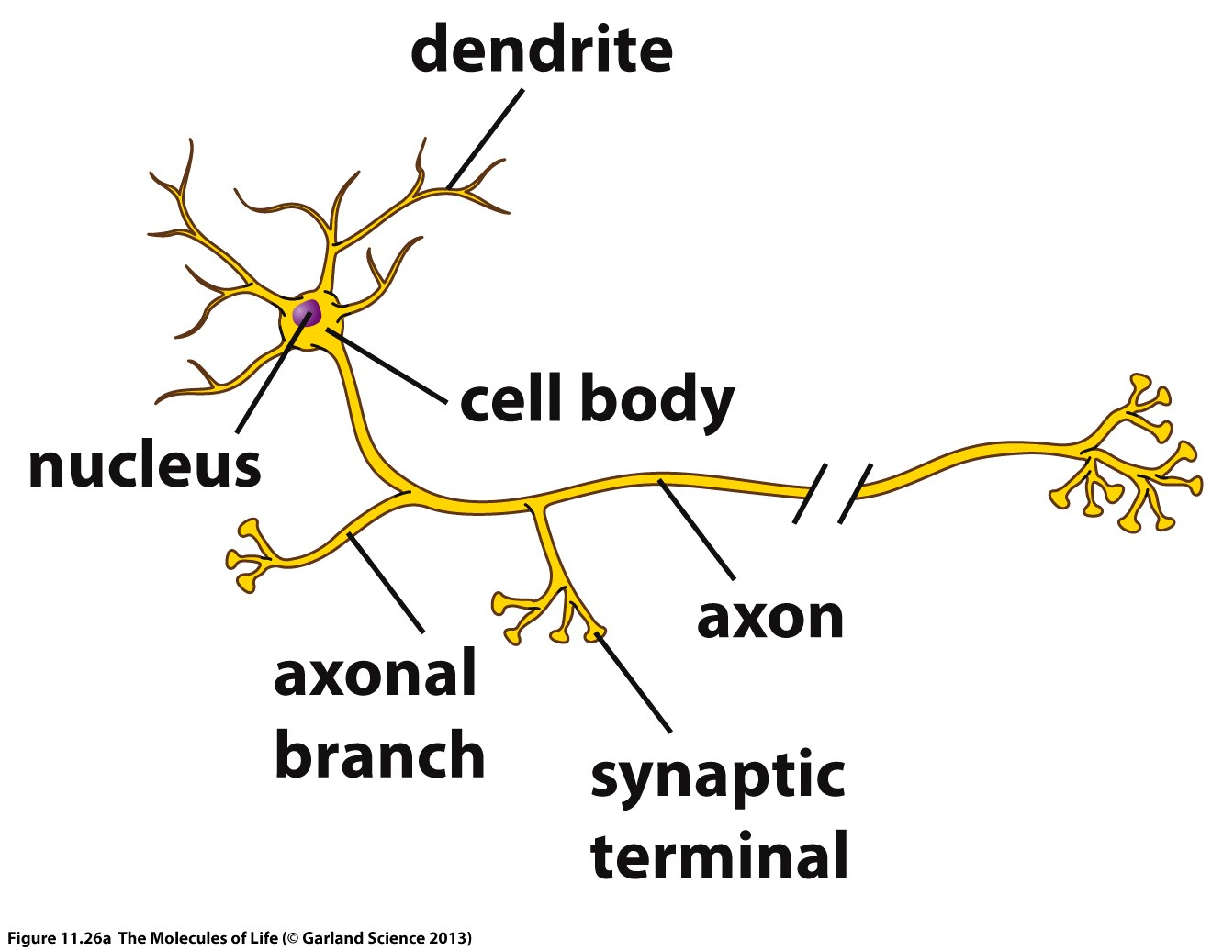
Notes:
All cells contain ion channels.
The cell type for which ion channels are most important are neurons.
Neurons consist of a cell body, a large number of dendrites which form the ”input” of the nerve cell and a single output, the axon, which connects to other nerve cells (or other cell types)

Slide 14
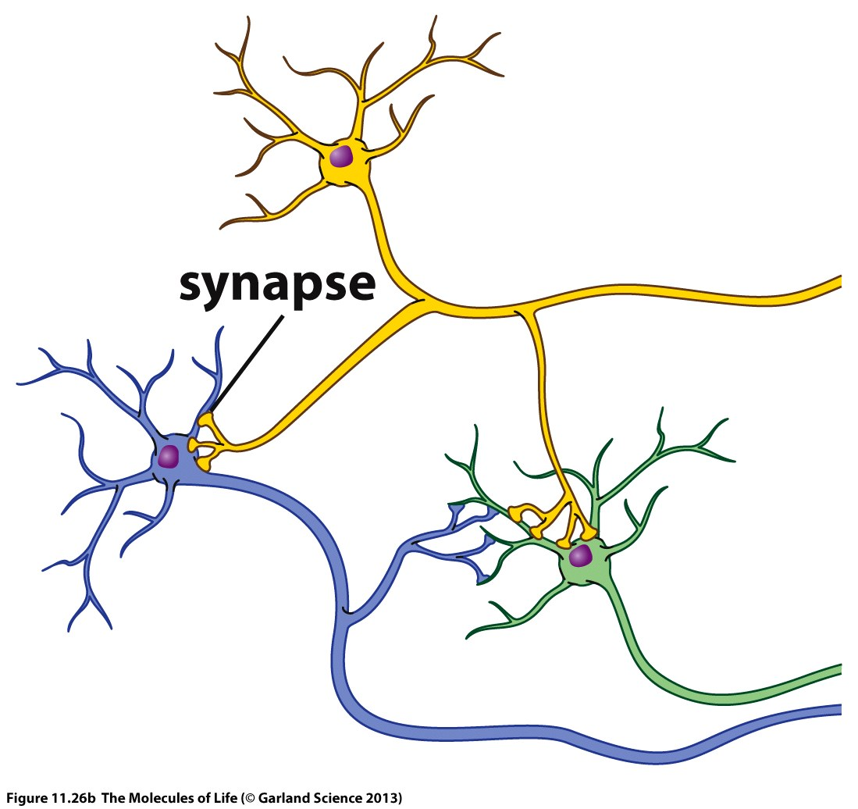
Notes:
The connection between a neurons axon and another nerve cells dendrite or cell body is the synapse.

Slide 15
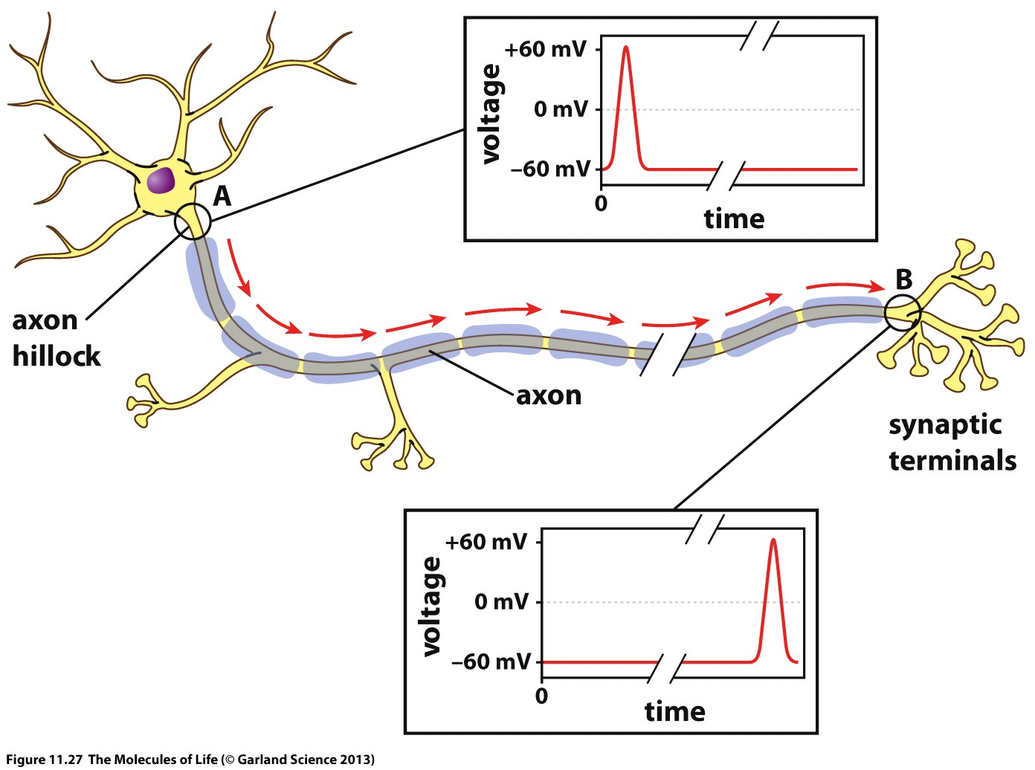
Notes:
The basis for nerve cell communication is the ability of nerve cells to form an action potential which is formed within the cell body and propagated along the axon.

Slide 16
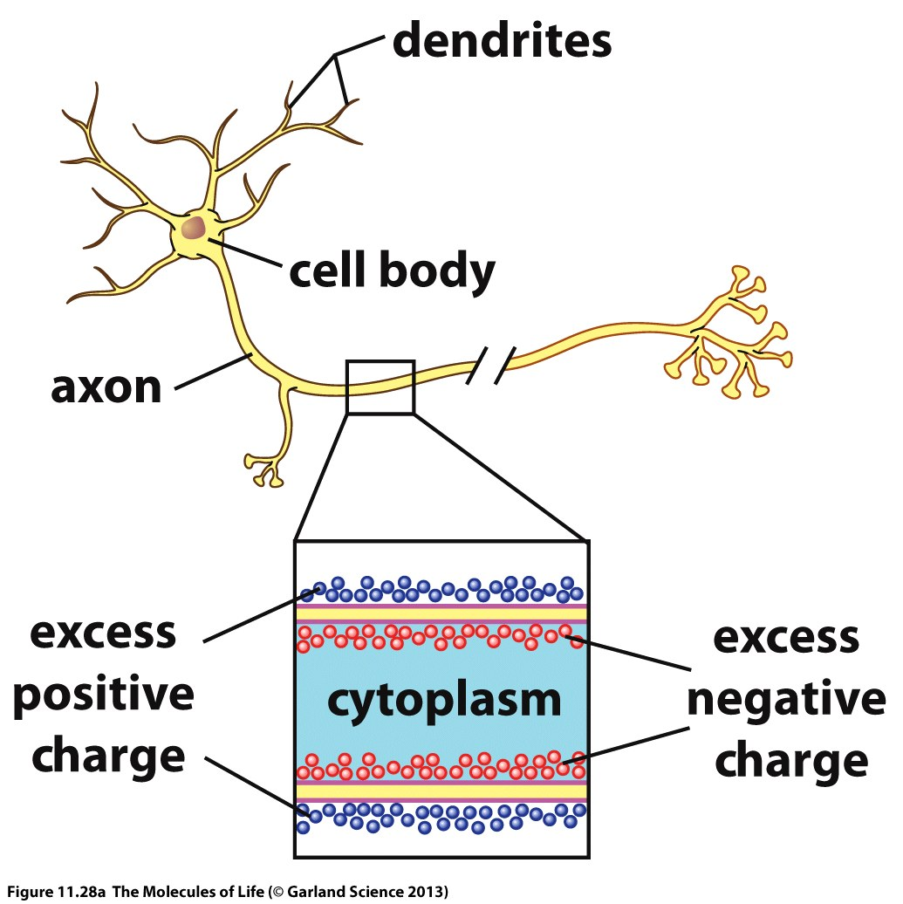
Notes:
The signal which travels is a local depolarization of the membrane which is controlled by voltage-gated ion channels.

Slide 17
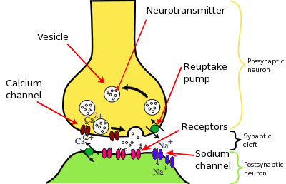
Synaptic Transmission
Notes:
In the synaptic terminal there are small bubbles filled with neurotransmitters, the vesicles.
Upon arrival of the action potential these vesicles fuse with the cell membranes and release their cargo into the synaptic cleft.
The neurotransmitters diffuse across the synaptic cleft and interact with ligand-gated ion channel of the postsynaptic neuron. The signal is transmitted from on cell to the next

Slide 18
Different Types of Ion Channels
Ligand Gated Ion Channels
Open in response to specific ligand molecules binding to the extracellular domain of the receptor protein.
Voltage Gated Ion Channels
Open and close in response to membrane potential.
Other Gatings
Indirect signalling, mechano-gated ion channels, light gated channels, temperature gated channels etc.

Slide 19
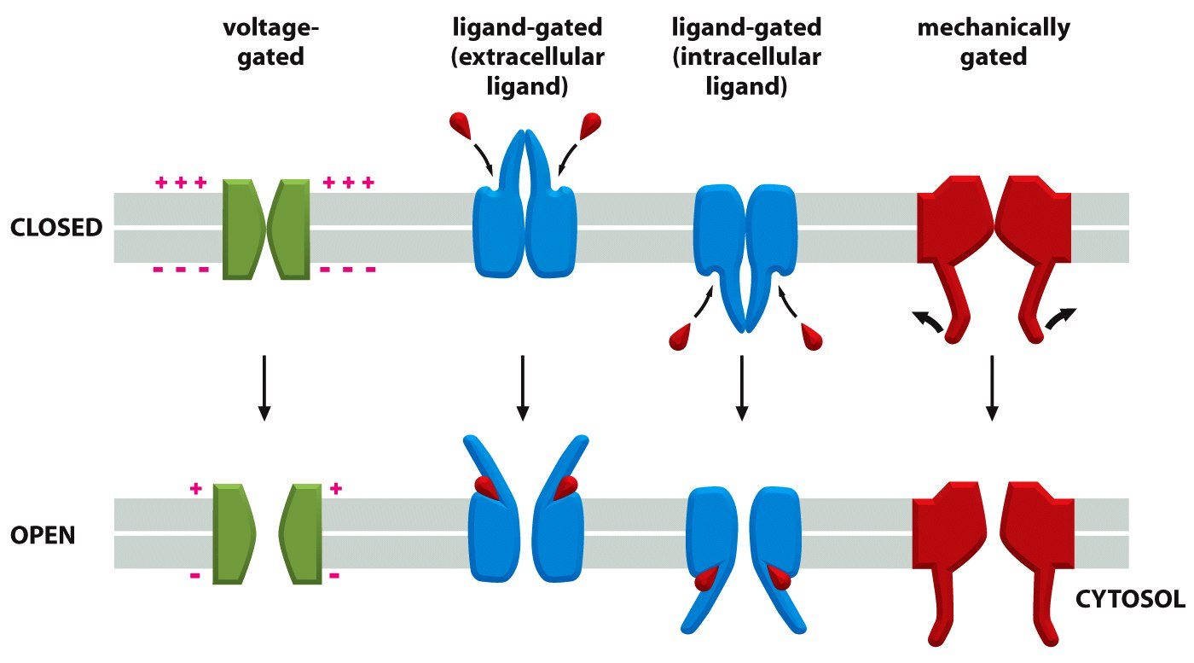
Notes:
For ion channels to work properly it is important that they can adopt different conformational states in response to external signals.
They need at least two functional states, a closed state in which ion cannot permeate and an open state in which ions can permeate.
Most ion channels are selective for one or few specific types of ions.

Slide 20
Ligand Gated Channels
Group of transmembrane ion channels that allow the passing of several ions upon the binding of specific chemical messenger like neurotransmitters.
Two domains: Transmembrane domain including channel pore, Extracellular domain including ligand binding site.
Function: Conversion of presynaptic chemical signal quickly and effectively into post-synaptic electrical signal.
Three super families: cys-loop receptors, ionotropic glutamate receptors and ATP-gated channels.
Nicotinic Acetylcholine Receptor

Slide 21
Notes:
The general concept of a ligand-gated ion channel is that they switch in response to binding of a ligand (neurotransmitter) from the closed to the open state, allowing permeation of ions.

Slide 22
Cys-Loop Receptors
Characteristic loop formed by a disulfide bond between two cysteine residues in the N terminal extracellular domain.
Provides specificity for (1) acetylcholine (AcCh), (2) serotonin, (3) glycine, (4) glutamate and (5) γ-aminobutyric acid (GABA) in vertebrates.
Structural elements are well conserved, with a large extracellular domain (ECD) harboring an alpha-helix and 10 beta-strands. Following the ECD, four transmembrane segments (TMSs) are connected by intracellular and extracellular loop structures.

Slide 23
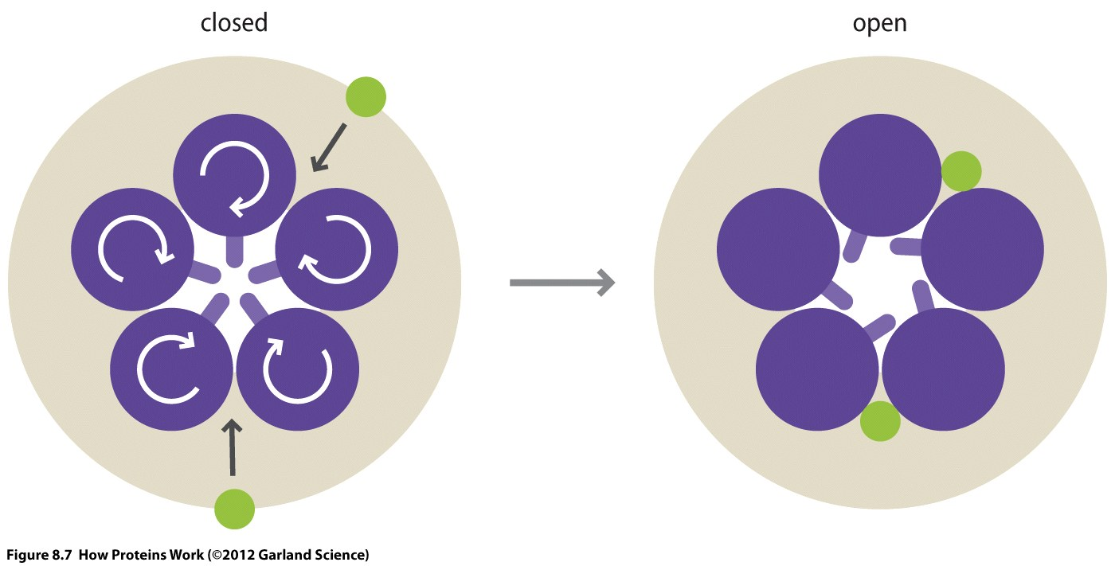
Gating Mechanism of Cys-Loop Receptors (GABA, nAChR)
Notes:
In the closed state the central pore is filled with hydrophobic residues which would require ions to strip off their water shell and interacting with residues which cannot make favorable interactions with water molecules. Consequently ion passage would be associated with a high energy barrier.
Upon ligand binding the 5 subunits undergo a rotation which changes the appearance of the inner pore. The hydrophobic residues are turned aside and now small hydrophilic side-chains are lining the pore. The energy barrier for ion conductance is now substantially reduced and ions can permeate along their concentration gradient.

Slide 24
Drugs Acting on the GABA Receptor
Diazepam (Valium)
Oxazepam
Benzodiazepines
Barbiturates
Phenobarbital
Pentobarbital
Notes:
The GABA receptor is the target for a wide range of marketed drugs.
Most notably the Benzodiazepine class which have a sedative and anxiolytic effect and are used to treat a wide range of psychiatric disorders like anxiety and panic disorders. They are also used to treat seizures.
Another class of drugs acting on the GABA receptor are barbiturates. The effect of these drugs ranges from mild sedation to anesthesia as well as analgesic effects. The treatment options range from anesthesia, to epilepsy but also acute migraine and cluster headache.
Pentobarbital is currently used for capital punishment in some states of the US.

Slide 25
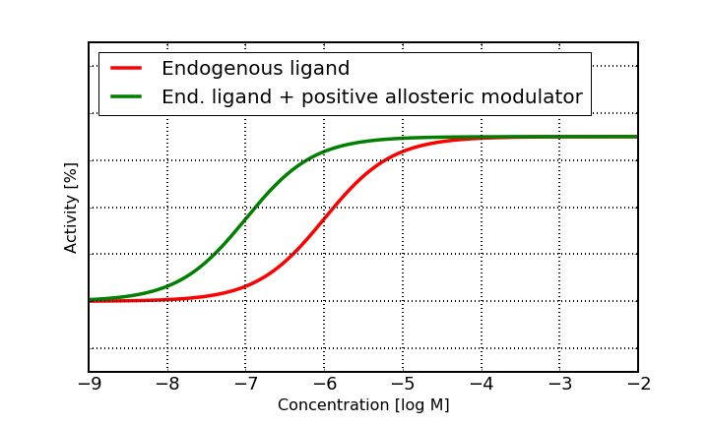
GABA
Benzodiazepines and barbiturates are positive allosteric modulators of the GABA receptor.
Notes:
The mode of action for these drugs is positive allosteric modulation. The drugs enhance the effect of GABA which leads to a dampening of the synapse. At high doses they also act as agonists.

Slide 26
Ionotropic Glutamate Receptor
Binds to NT Glutamate.
Consists of a tetramer.
Each sub-unit consists of extracellular amino terminal domain (ATD, which is involved in tetramer assembly), an extracellular ligand binding domain (LBD, which binds glutamate), and a transmembrane domain (TMD, which forms the ion channel).
Each subunit of the tetramer has a binding site for glutamate formed by the two LBD sections forming a clamshell like shape.

Slide 27
Notes:
The NMDA receptor needs two signal molecules to switch from the closed to the open state. Glycine and Glutamate.
The neurotransmitters bind to extracellular domains which have the same fold as periplasmic binding proteins in bacteria and the extracellular domain of class C GPCRs. It’s a nice example how successful designs of nature are reused in a modular way.

Slide 28
http://www.cell.com/cell/pdf/S0092-8674(16)30326-9.pdf
The conformational rearrangements of the NMDAR are very complex and an intensive field of research. In the publication above this mechanism has been studied by electron microscopy demonstrating the remarkable opportunities this technology provides to study large protein complexes.

Slide 29
Ligand-gated ion channels are of particular importance for brain function, e.g. cognition, learning, mood and behavior.
Consequently they are of great interest for pharmaceutical research and modulators of these types of receptors are developed for indications such as depression, Alzheimer’s, schizophrenia and other CNS disorders.

Slide 30
a) Voltage Gated ion channels
Voltage sensitive
Conformational change in response to the potential gradient.
Generally ion specific.
Important for excitable cells like neurons.
Role in regulation of depolarization and polarization of neuronal membrane during an action potential.
Distributed along the axon and soma of the neurons.

Slide 31
Types of Voltage Gated Channels
Voltage Gated Sodium Channels (9 members, responsible for membrane depolarization in action potential generation)
Voltage Gated Calcium Channels (10 members,play an important role in both linking muscle excitation with contraction as well as neuronal excitation with transmitter release. )
Voltage Gated Potassium Channels (40 members, role in repolarization of cell membrane after action potential generation.)

Slide 32
Extracellular space
Activation
Inactivation
Deactivation
Cytoplasmic space
Closed Resting potential
Open
Activation threshold
Closed
Hyperpolarization
Notes:
Voltage-gated ion channels can switch between three different conformational states. The closed state, the conducting open state and an inactivated state.

Slide 33
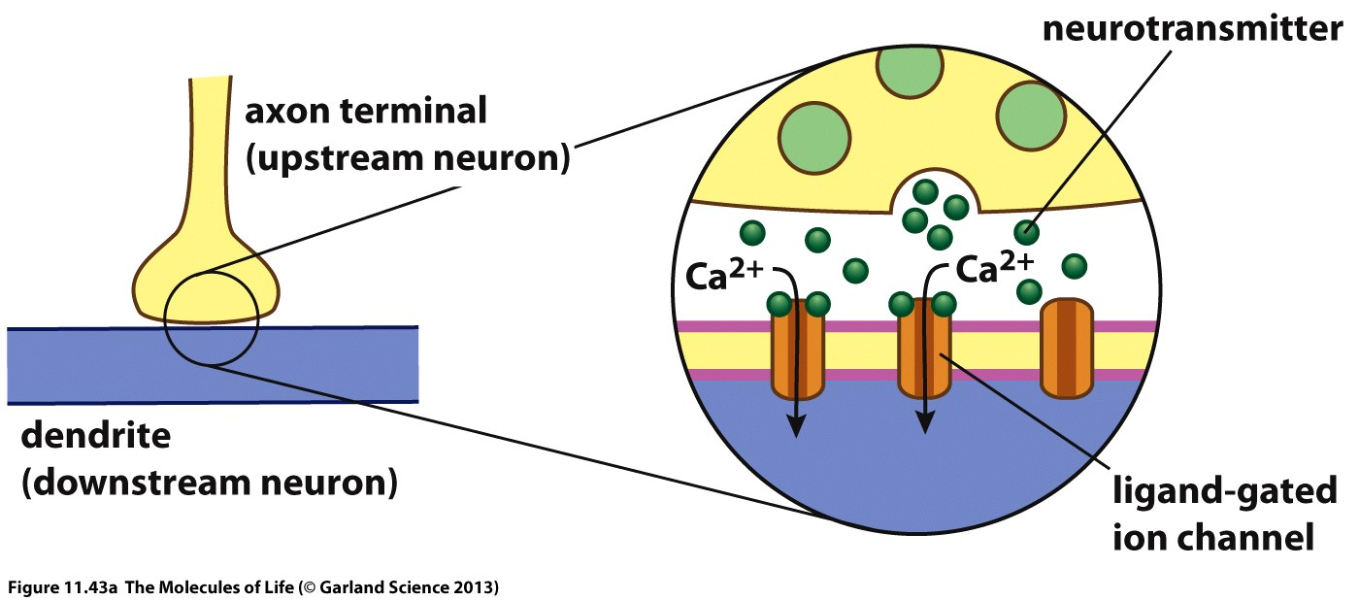
Notes:
The opening of ligand-gated ions channels on the postsynaptic neuron causes a depolarization of the membrane potential, e.g. from -70mV to -30 mV. This change in membrane potential is recognized by voltage-gated ion channels.

Slide 34
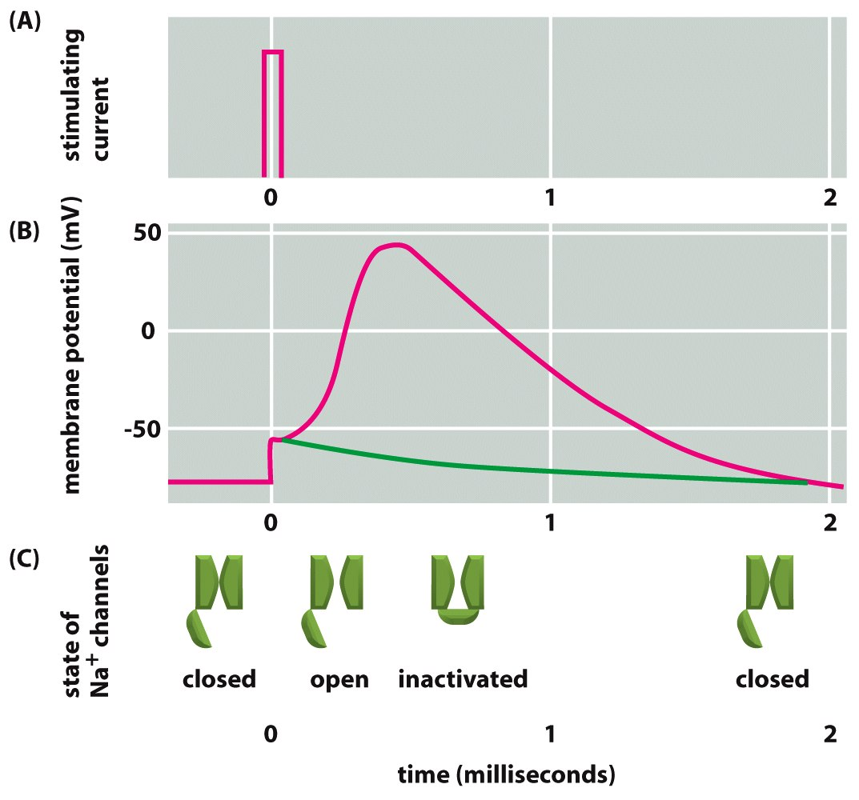
Notes:
Voltage-gated ion channel open in response to a change in the membrane potential, e.g. initiated by a ligand-gated ion channel. The opening allows ions to rapidly flow across the channel leading to a local depolarization of the membrane. The open state is very short-lived. After a few hundred microseconds the channel switches into an inactivated state.
Out of the inactivated state the channel cannot open again in response to depolarization. It is desensitized. It first has to undergo another conformational change back to the close conformation when the membrane potential goes back to the resting state.

Slide 35
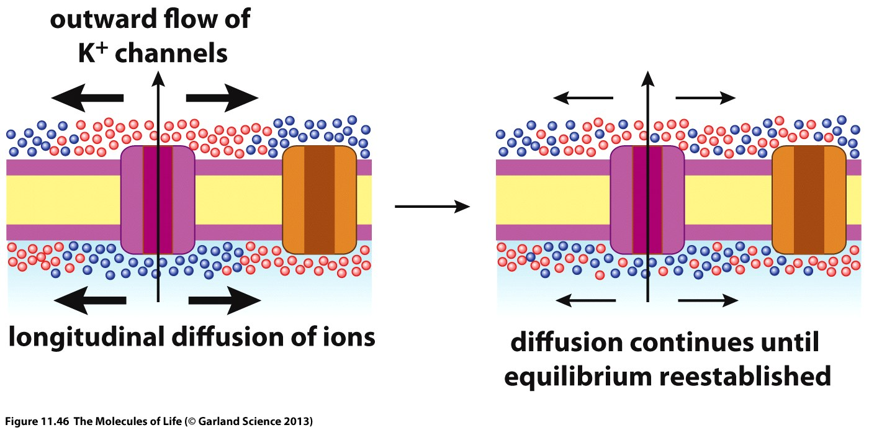
Notes:
The desensitation is important to allow for a directional flow of the action potential. The local concentration arising from an open ion channel travels longitudinal in both directions of the axon.
However, at the side where the signal is coming from the ion channels are in the inactivated state which allows the signal to propagate only in the other direction.

Slide 36
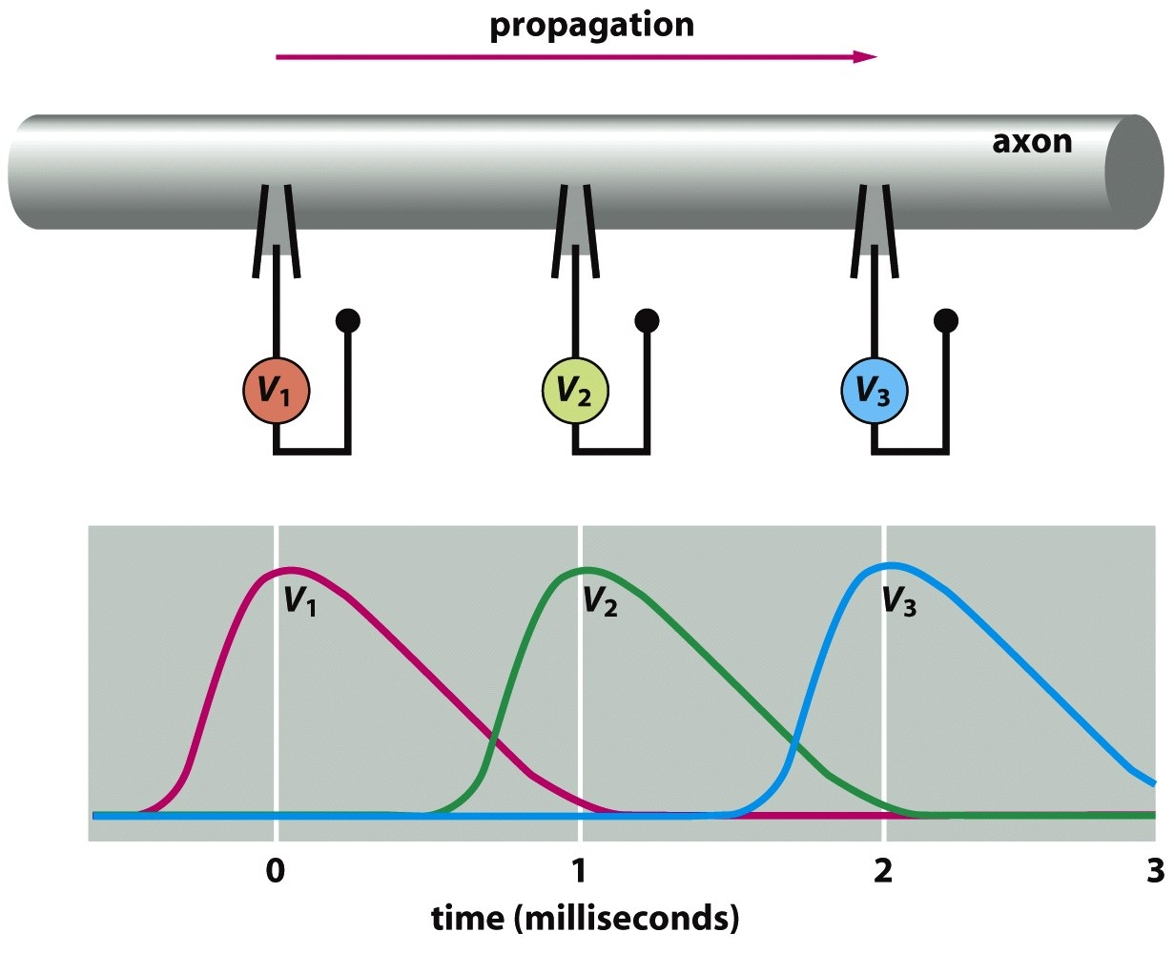

Slide 37
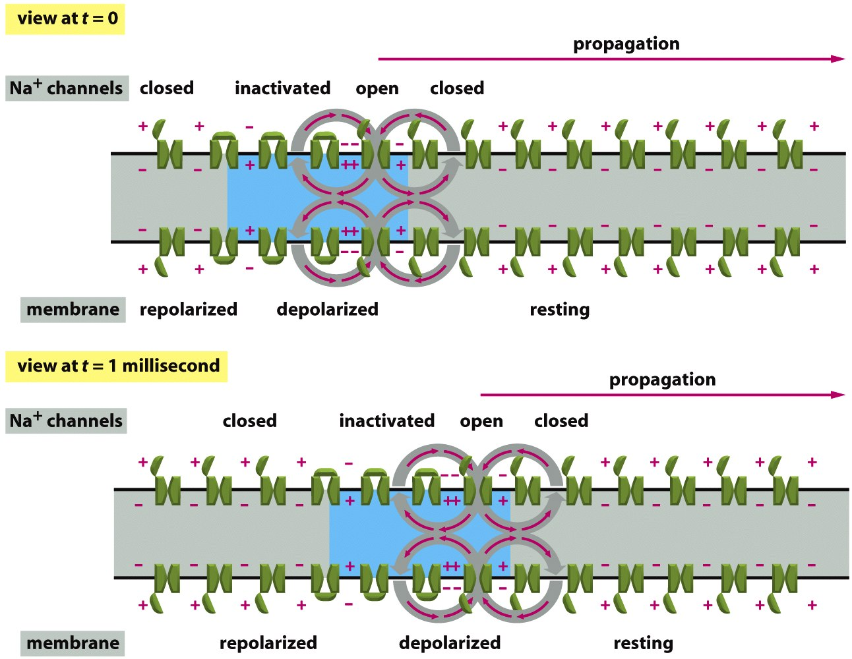

Slide 38
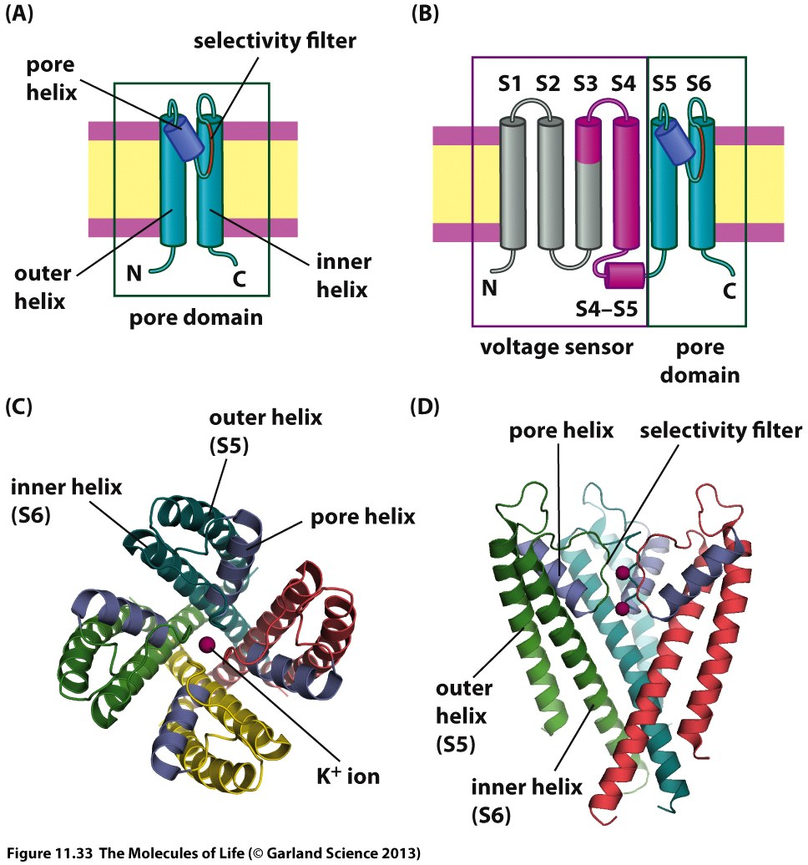
Notes:
Voltage-gated ion channels are ion-specific. This specificity is determined by a region in the protein which is called selectivity filter.

Slide 39
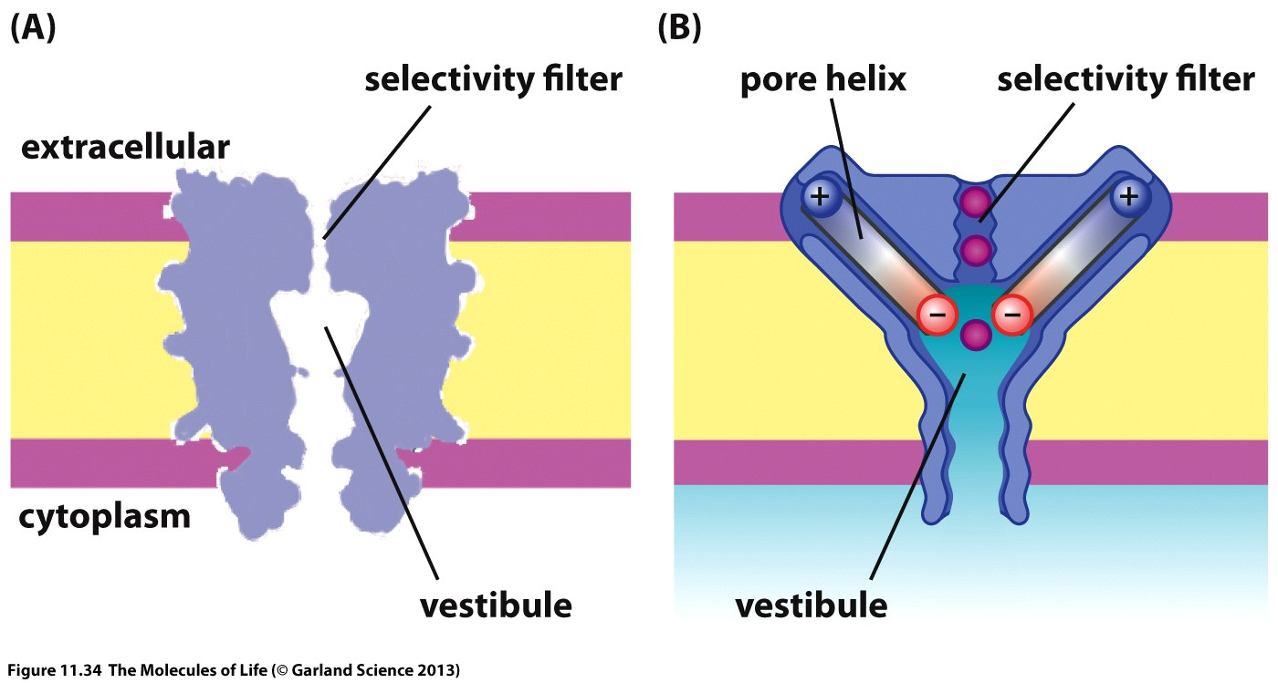
Notes:
The pore of the ion channel consists of a narrow part which is responsible for ion selectivity. Further down is a large hydrophobic cavity which allows water molecules to fill the pore and resolvate the ions ones they are halfway through the channel.
A pore helix creates a negative electrostatic potential which attracts ions into the channel.

Slide 40
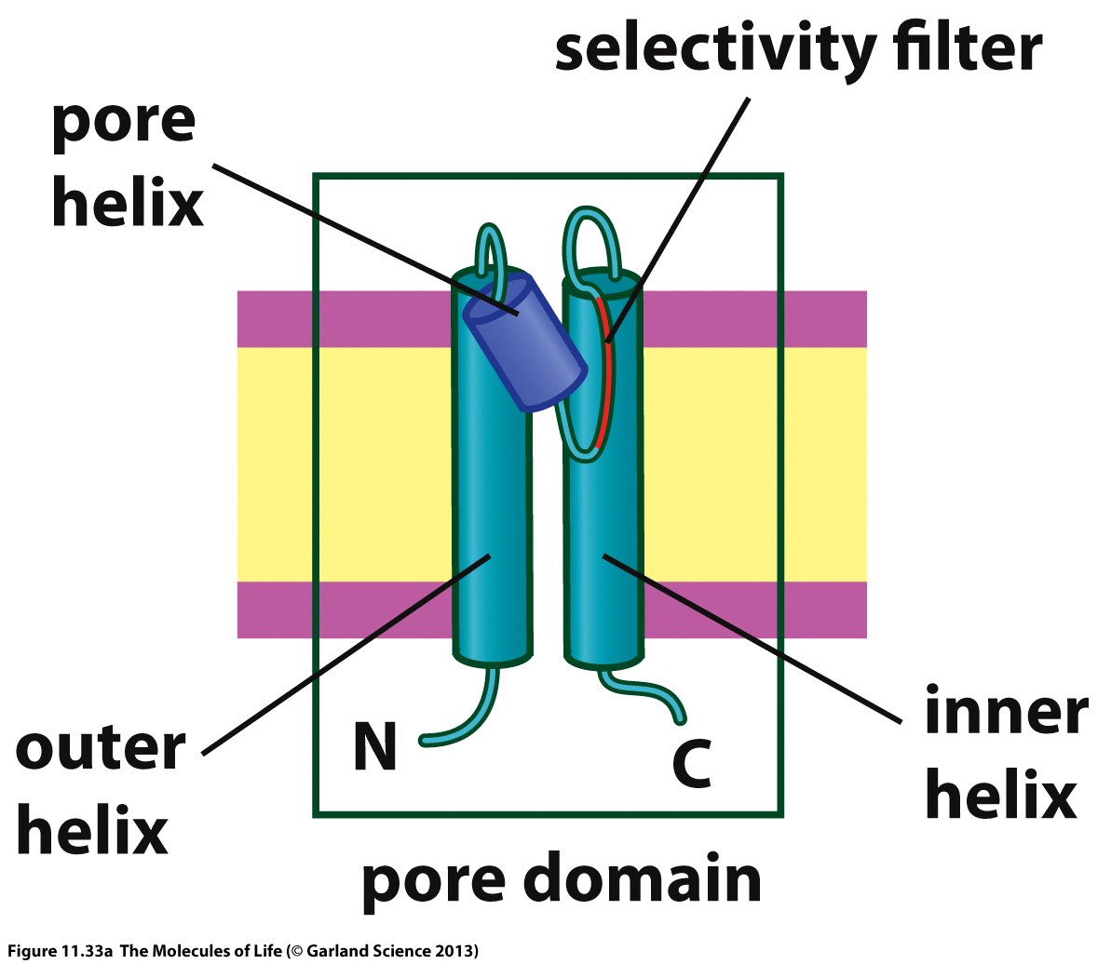

Slide 41
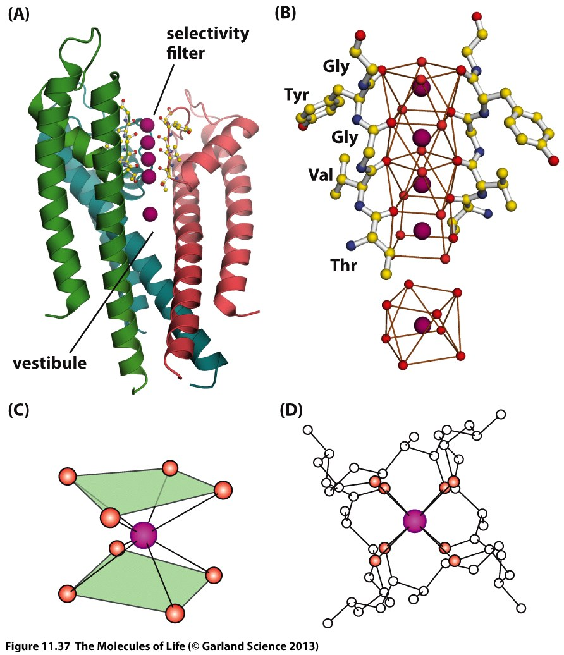
Notes:
The selectivity filter is designed such that carbonyl groups are lined-up along the pore in a distance which optimally fits the ion for which the channel is selective. The interaction energy with the carbonyl groups must ideally compensate for the solvation shell the ion has to strip off in order to enter the channel.

Slide 42


Slide 43
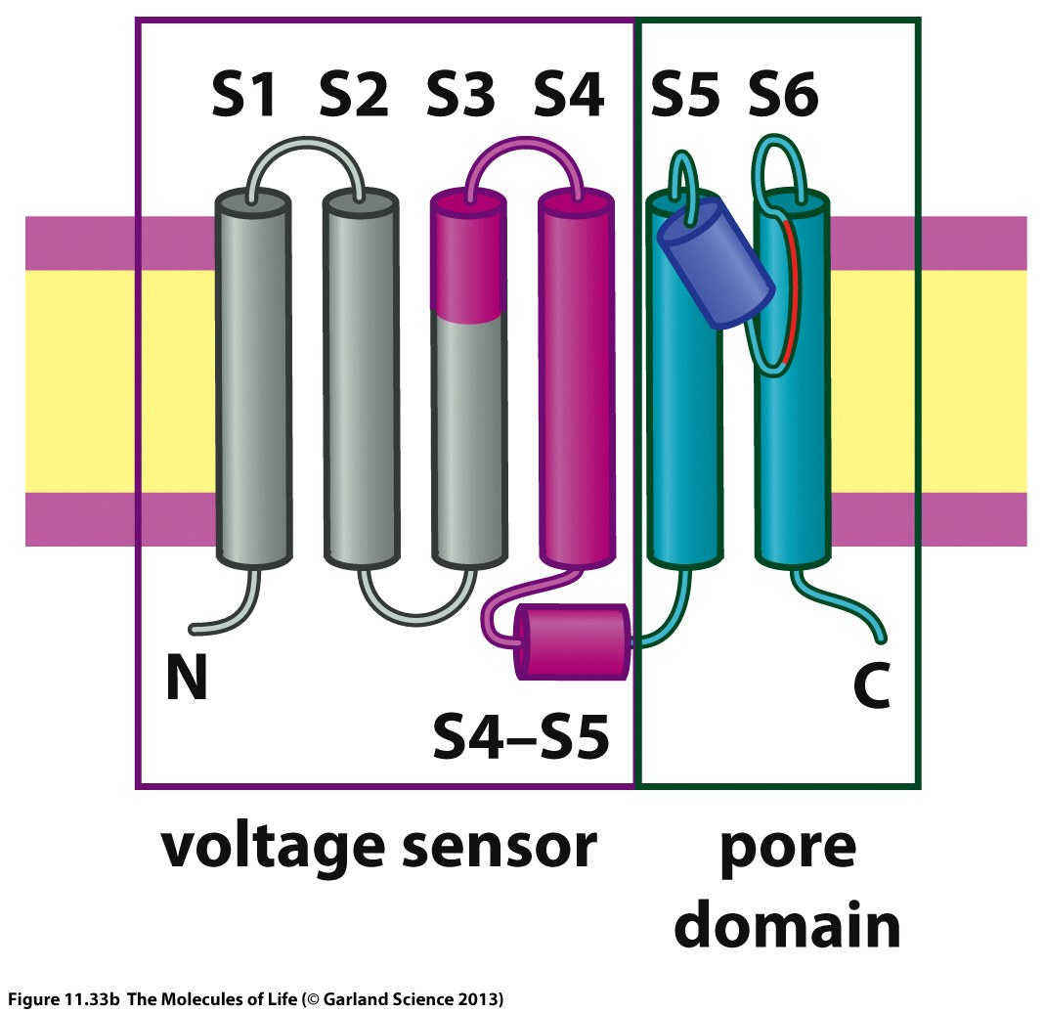

Slide 44
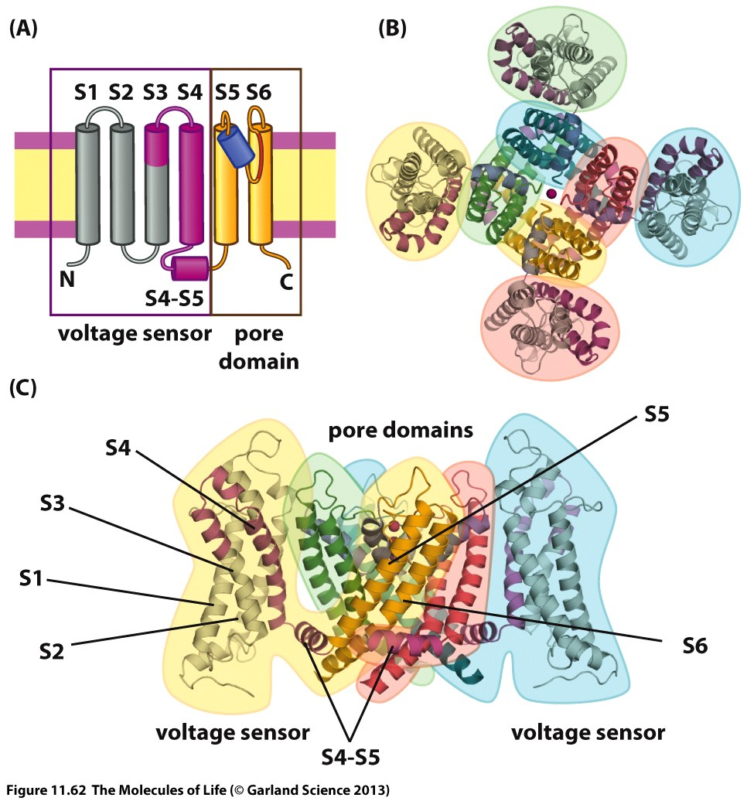

Slide 45
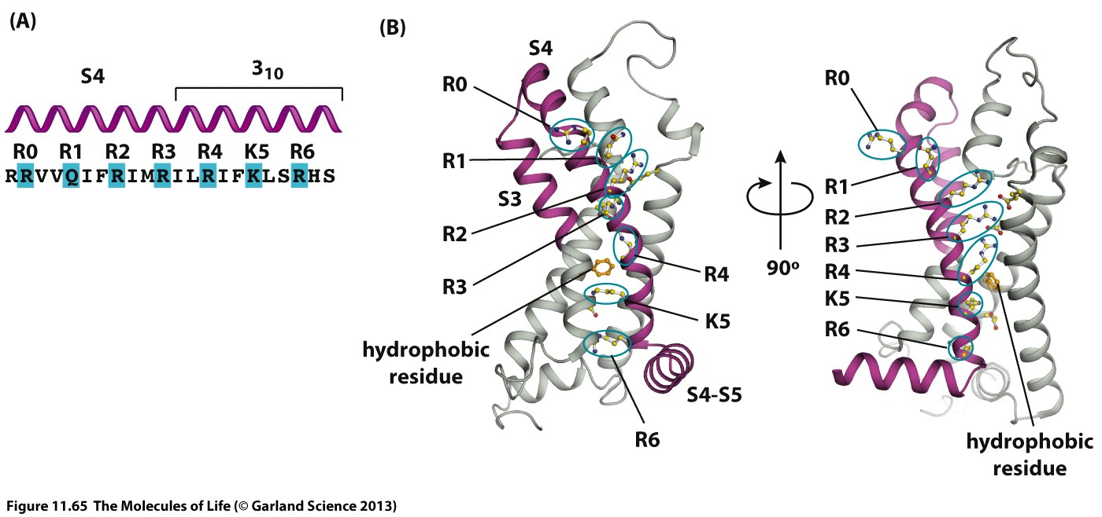
Notes:
The voltage-sensor consist of a four-helix bundle with several positively charged residues lined-up. Upon depolarization the positive charges in the voltage-sensor respond to the electric field and induce a conformational change which pulls the ion channel into the open conformation.

Slide 46
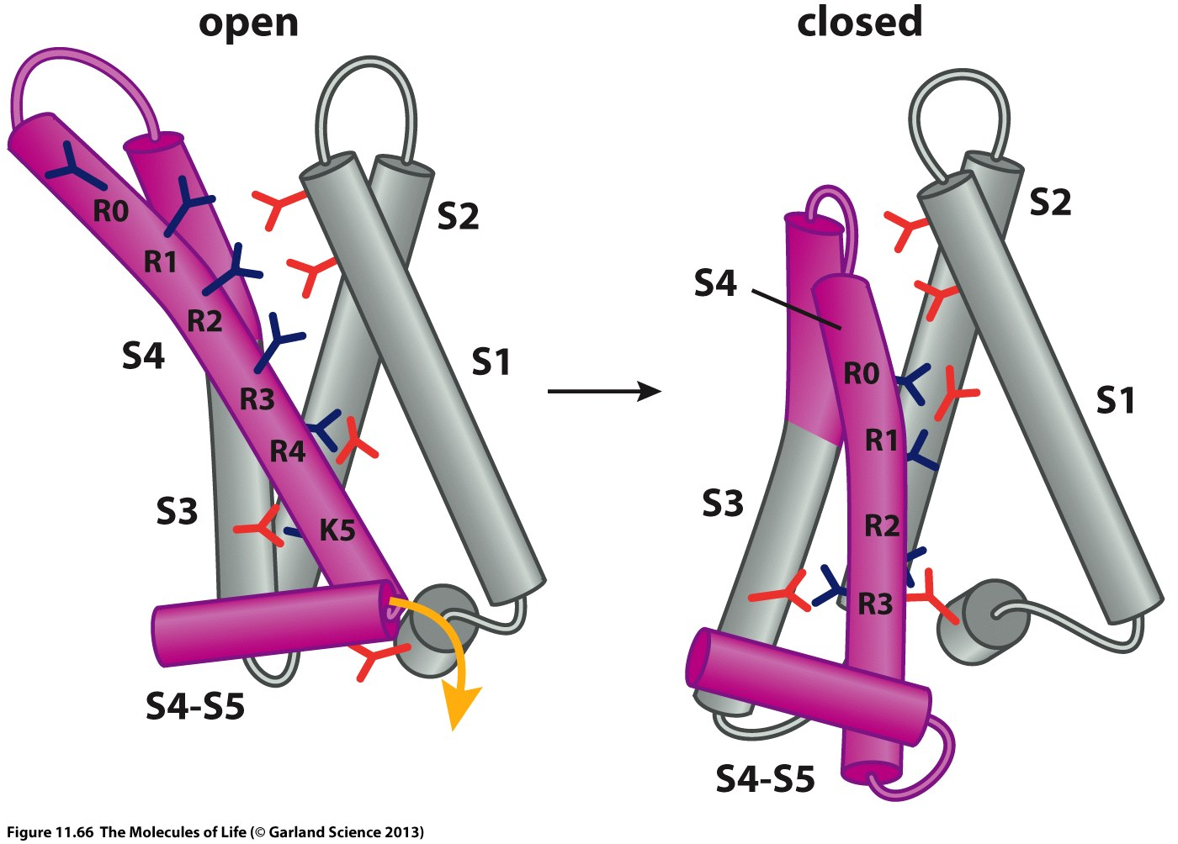

Slide 47
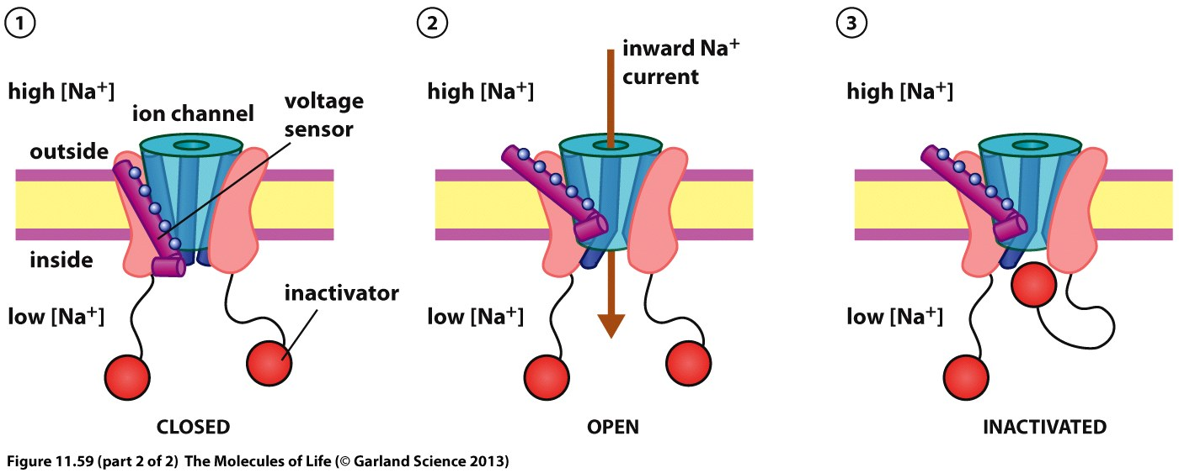

Slide 48
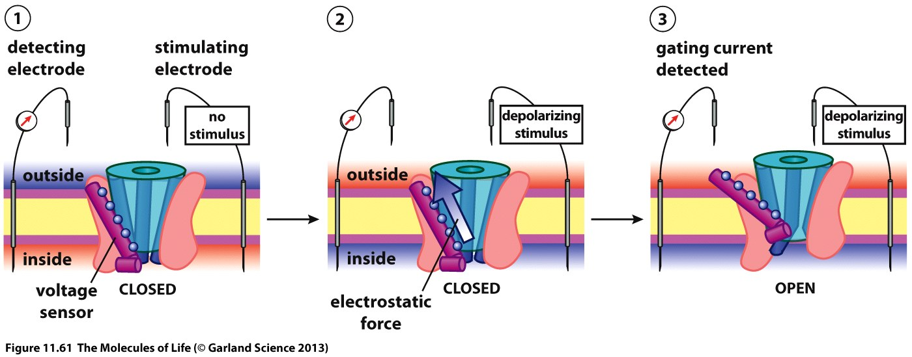

Slide 49
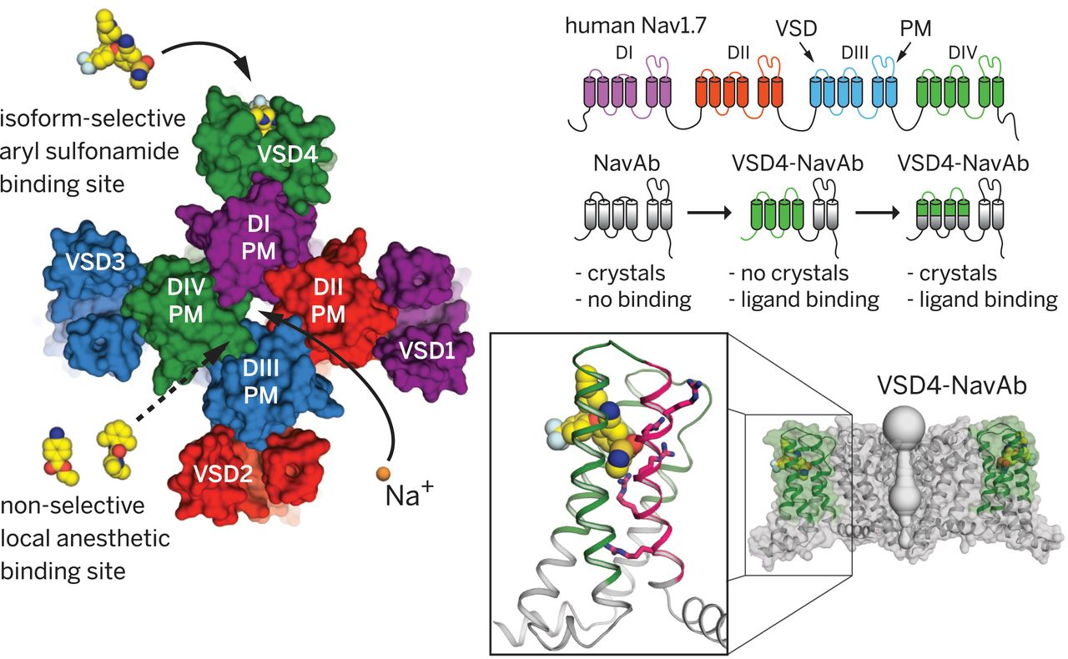
Ahuja et. al., Science 2015

Slide 50
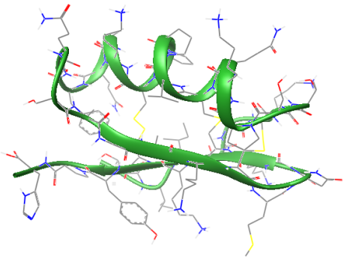
D
D
D
D
(a)
(b)
(c)
(d)
Flecainide,
NaV1.5 blocker,
Antiarrhythmic
(e)
(f)
(g)
Retigabine,
Kv7.2,Kv7.3 channel opener, anti seizure agent
Margatoxin, Kv1.3 blocker
Scorpion venom

Slide 51
Tetrodoxin
Blocker of Na⁺-Channels
Batrachotoxin
Irreversible opening of Na⁺-Channels
Amlodipine
Ca²⁺⁻Channel inhibitor
Verapamil
Ca²⁺⁻Channel inhibitor

Slide 52
Calcium channel blockers
Depolarisation
Open conformation
D
Free Energy
Inactivation
Closed conformation
Conformational coordinate
Different modes of action, tissue selectivity

Slide 53
Open conformation
Closed conformation
ΔG (-90mV)
Free Energy
ΔG (-60mV)
Conformational coordinate

Slide 54
-60 mV
Closed conformation
Open conformation
D
Free Energy
D
D
Inactivation
ΔG_{bind} (-60mV)
Conformational coordinate

Slide 55
-90 mV
Closed conformation
Open conformation
D
Free Energy
ΔG_{bind} (-90mV)
D
D
Inactivation
Conformational coordinate

Slide 56
Dihydropyridine class of L-type Calcium Channel blockers
Inhibition of L-type Calcium Channels (CaV1.2, CaV1.3)
CaV1.2 is expressed on smooth muscle cells and cardio myocytes
Amlodipine
Ca²⁺⁻Channel inhibitor
CaV1.2 inhibition on smooth muscle cells leads to vasodilation (desired effect of blood pressure decrease)
D
CaV1.2 inhibition on cardiac muscle cells affects regulation of the cardiac action potential and is an undesired effect.

Slide 57
Dihydropyridine class of L-type Calcium Channel blockers
Dihydropyridines bind to the inactive conformation of the channel.
Consequently dihydropyridines display a strong voltage-dependency in their ability to bind and modulate CaV1.2 channel function
Amlodipine
Ca²⁺⁻Channel inhibitor
Cardio myocytes and smooth muscle cells differ substantially in their resting membrane potential (-90mV vs. -60mV). Therefore DHPs have a much higher affinity/activity to CaV channels in smooth muscle cells and do not affect CaV1.2 function in cardio myocytes.
D

Slide 58
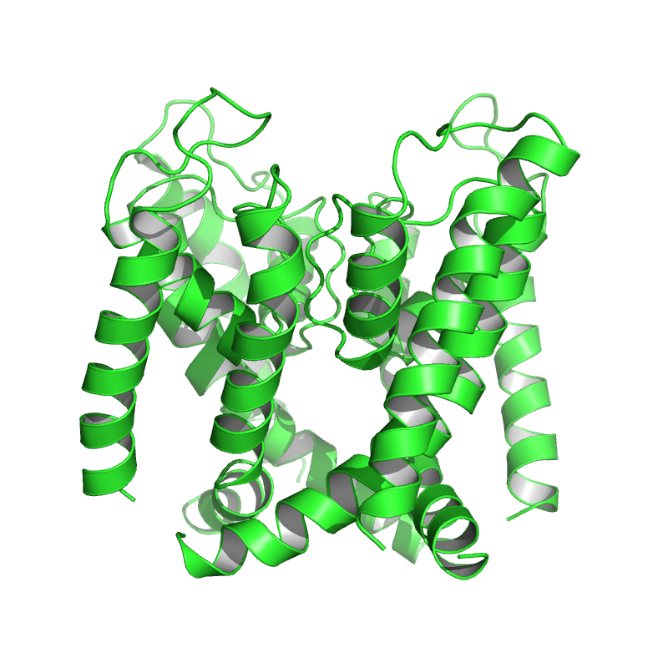
The hERG potassium channel
The hERG channel is important for conducting K⁺ ions out of heart muscle cells to return to the resting state.
Its correct function is critical for the correct duration of the action potential
Blockage of the channel by drugs is causing the ”aquired long QT-syndrome” which creates an increased risk of sudden cardiac death.
Model of the hERG channel

Slide 59
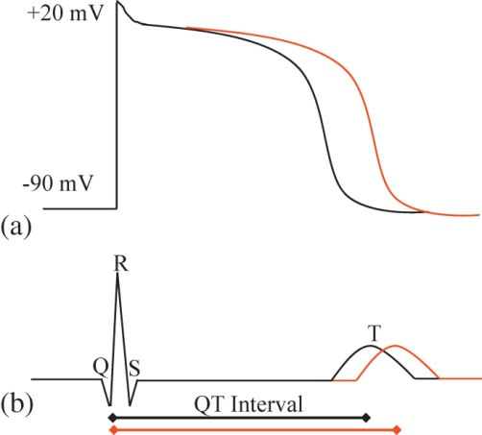
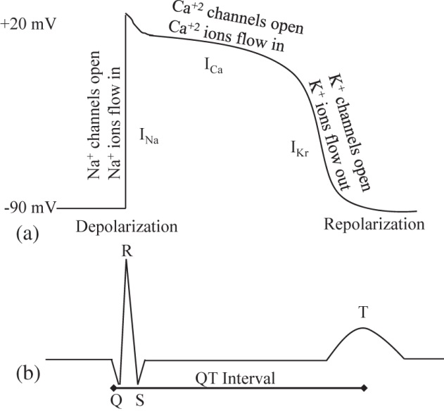
Cardiac Action Potential
Figure 8.16
Figure 8.17

Slide 60
Many drugs had to be removed from the market due to interaction with the hERG channel.
Astemizole, anti-histamine
Terfenadine, anti-histamine

Slide 61
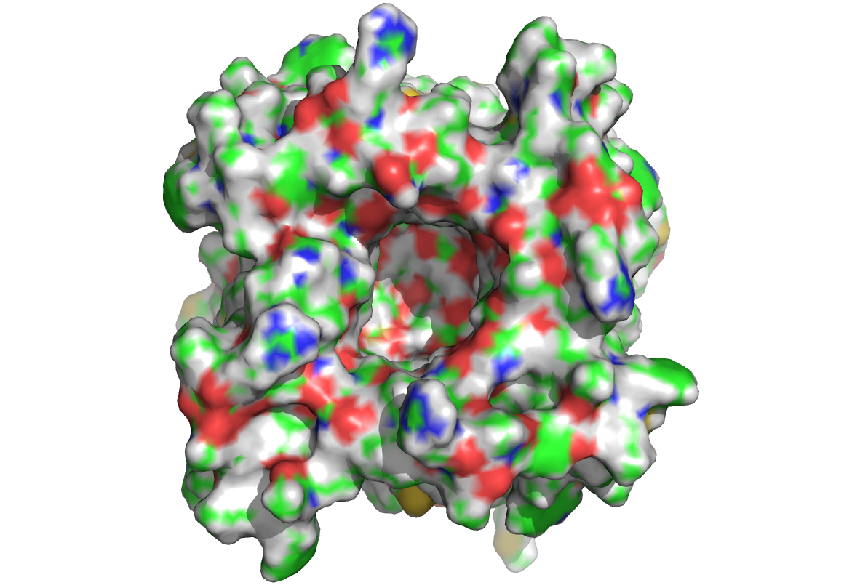
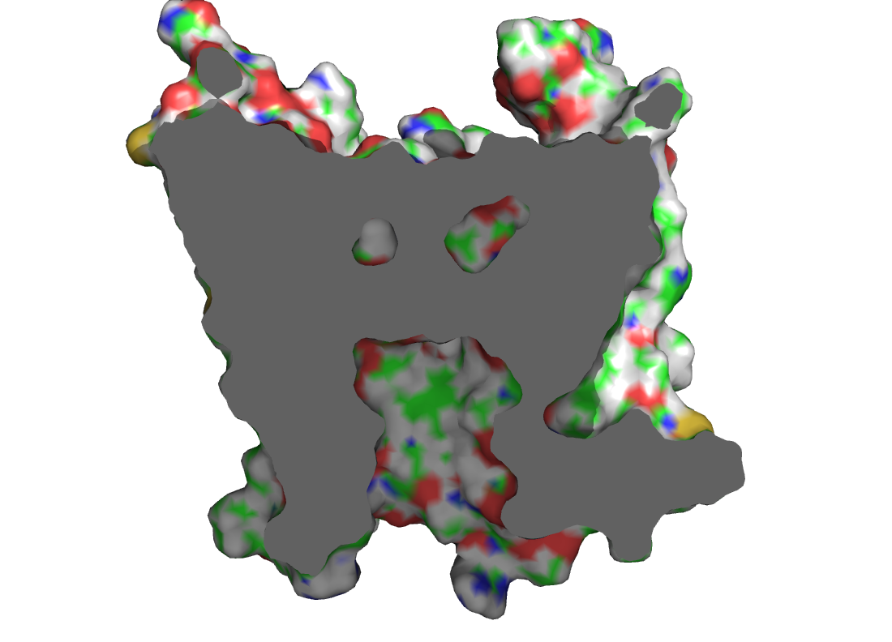
View from intracellular site
Large vestibule

Slide 62
Many organic molecules interact with the hERG channel and other voltage-gated ion channels
Aryl
basic nitrogen
Aryl
The most potent channel blockers are compounds which have two aryl moieties and a central basic nitrogen
Assessment of hERG blockage is a standard task in modern drug discovery and done for every compound which becomes of interest in a drug discovery program.

Slide 63
Channelopathies
Congenital insensitivity:
Mutation in the gene coding for the sodium channel NaV 1.7 which is responsible for pain perception
People are not able to feel physical pain
Cystic Fibrosis:
Mutations in a chloride channel (CFTR)
Impaired electrolyte balance leading to mucus accumulation in organs
Timothy Syndrome:
Mutation in the voltage-gated calcium Channel CaV1.2
Cardiac arrhythmia and autism spectrum disorders

Slide 64
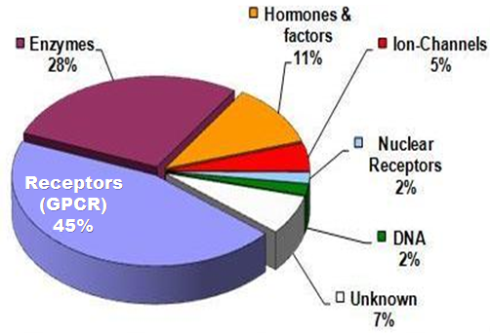

Slide 65
General considerations for target selection

Slide 66
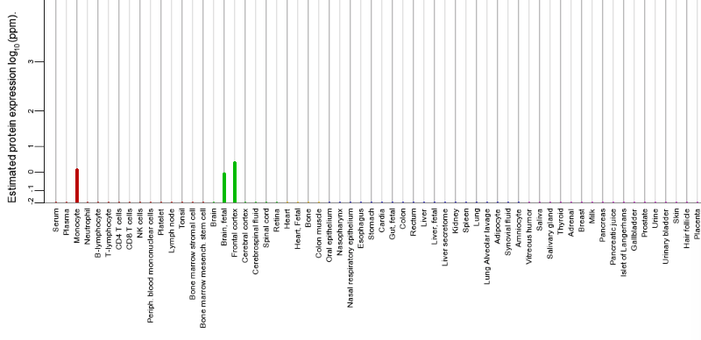
Where is the target located?
NMDAR
Exclusively located on the brain

Slide 67
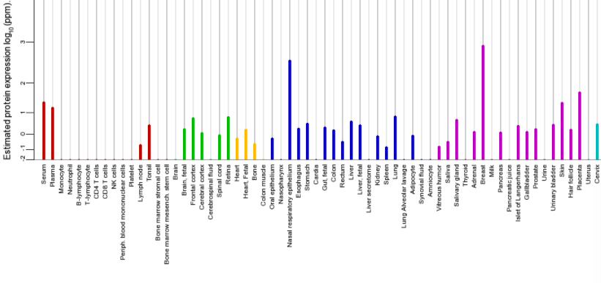
Where is the target located?
EGFR
Expressed in almost all tissues

Slide 68
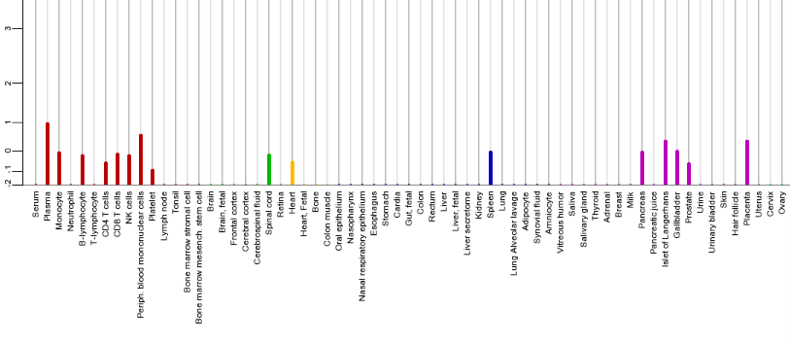
Where is the target located?
RIPK2
Located primarily in white blood cells but also in pancreas, gallbladder and placenta

Slide 69
Most proteins/receptors are expressed in different tissues/organs
Focus of a drug discovery project is usually distinct tissue/organ
Activity of the drug in tissues which are not in focus can give rise to unwanted side-effect or target-related toxicity.

Slide 70
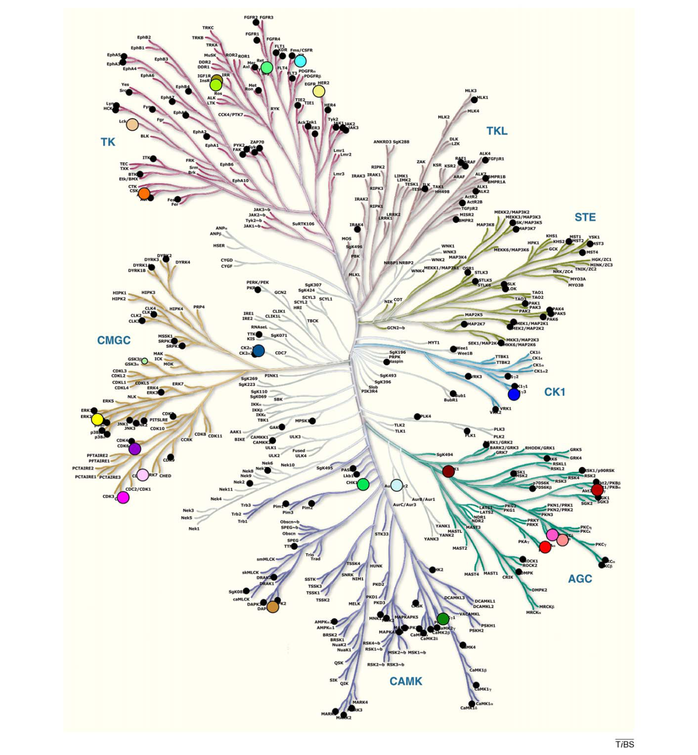
Selectivity
Interesting drug targets are often members of protein families which means they are similar in sequence and structure
Hitting other targets in addition to the target of interest can cause unwanted side-effects and off-target related toxicity
Achieving selectivity for a drug can be very challenging and is a frequent cause why drug discovery programs have to be terminated unsuccessfully

Slide 71
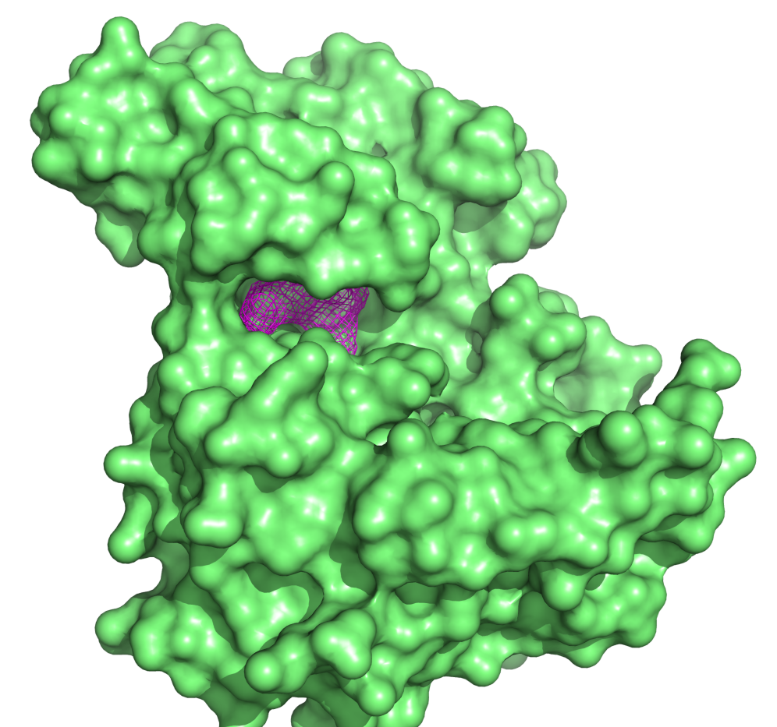
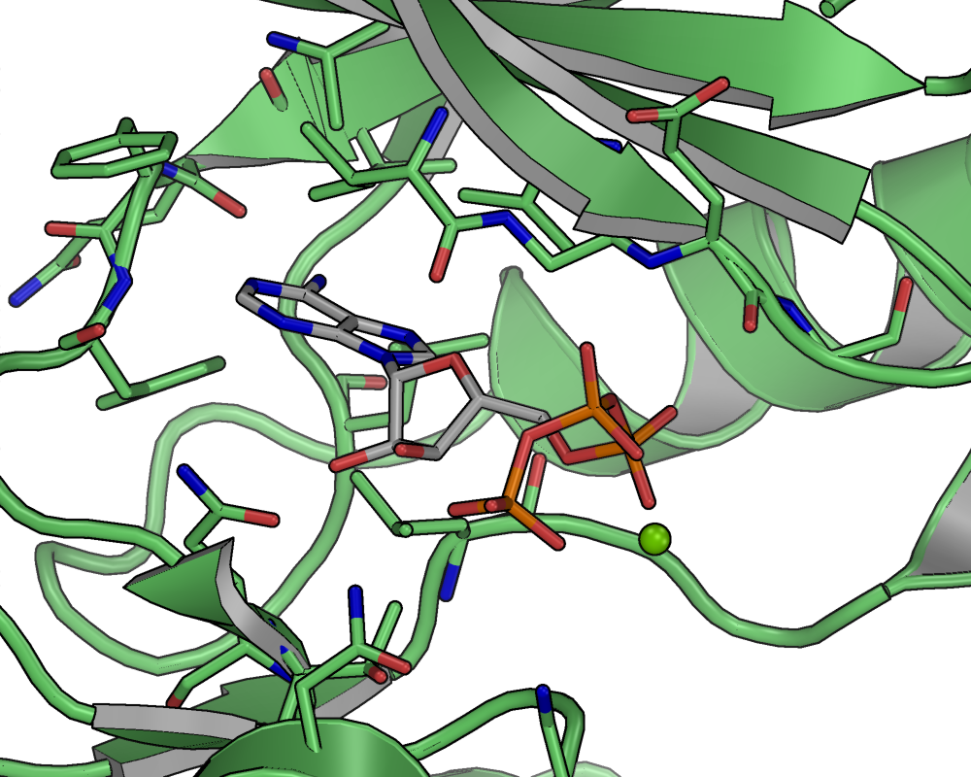
Druggability
Targeting proteins which naturally bind small molecule ligands are much more likely to be successfully ”drugged” than proteins whose function does not involve small molecule binding
A large fraction of pharmaceutically interesting proteins only have other proteins as natural binding partners.

Slide 72
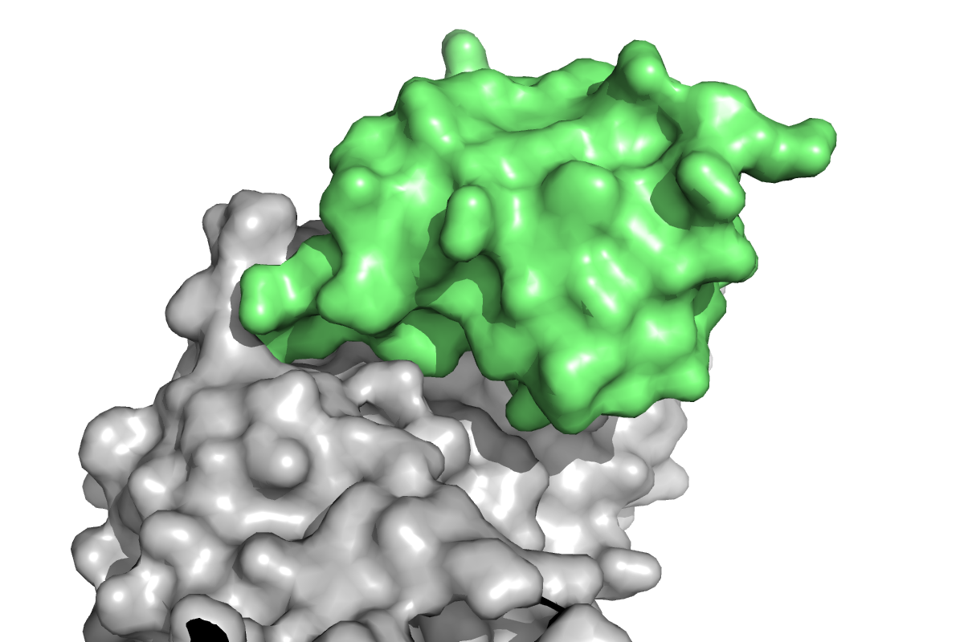
Protein-protein binding interfaces (PPIs) have a larger interaction area and are often shallow
The contribution of each amino acid to the overall binding energy is much smaller than for small molecule binding sites
Many interactions of this type have been tried to be addressed with small molecule ligands. The majority of approaches have failed. Therefore this type of interaction is often regarded as ”undruggable”.

